Slide 1
Dispute Resolution (Resolution of Private International Disputes)
Session 2: Introduction to Jurisdiction
FTU Master Program
Wednesday, 1st March 2016
Prof. Dr. Wolfgang Wurmnest, LL.M. (Berkeley)

Slide 2
Jurisdiction
The international and comparative perspective

Slide 3
Introduction (repetition from last session)
Jurisdiction = Power of a court to hear and decide a case
International jurisdiction (this is what we discuss in class)
Subject matter jurisdiction (which court within a court system has the power to decide the case)
Venue (“local” jurisdiction)
Who has the power to enact rules on jurisdiction?
Each State can design rules for its own courts
Consequences:
More than a single court in one country might have jurisdiction
No court might have jurisdiction

Slide 4
Introduction (2)
Boundary each State must respect: jurisdiction rules must be consistent with international law
Genuine link (connection) between case and State
P: transnational litigation involves interests of more than one State
Different views in the world under which circumstances it seems “just and fair” that a court shall have jurisdiction
Mutual accusations of “exorbitant jurisdictional bases” frequent

Slide 5
Different approaches to jurisdiction

Slide 6
The common law approach to jurisdiction
What does „common law“ mean? In a nutshell:
Opposite of „civil law“
Legislation: few statutes, no comprehensive civil code
Case law, „judge made law“ (important role of the judge)
Which countries are common law countries?

Slide 7
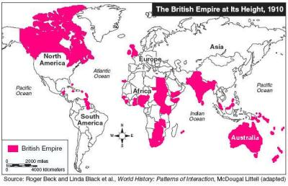
The British empire

Slide 8
Common law approach (2)
UK (if EU law does not apply), other common law countries outside the EU such as U.S., Canada, Australia, Singapore, Hong Kong
Common law approach prefers flexible handling of the individual case (at the expense of certainty and foreseeability).
Common law countries tend to have more far-reaching rules of jurisdiction
Jurisdiction can be established by
Transient physical presence within the territory of the state,
Or other “minimum contacts” (eg doing business)
However, the court may (= discretion) choose not to exercise its jurisdiction because it believes some other court would be substantially more appropriate (doctrine of forum non conveniens)

Slide 9
Continental European approach
Also EU law, incl. UK
Prefers clear rules and foreseeability of results at the expense of flexibility.
European Court of Justice, Case C-256/00 – Besix
“The Court has repeatedly held that the principle of legal certainty is one of the objectives of the Brussels Convention [now: Regulation].
That principle of legal certainty requires, in particular, that the jurisdictional rules (…) should be interpreted in such a way as to enable a normally well-informed defendant reasonably to foresee before which courts, other than those of the State in which he is domiciled, he may be sued.”
See also Recital 15 Brussels Ia Regulation (“recast”): “The rules of jurisdiction should be highly predictable…”

Slide 10
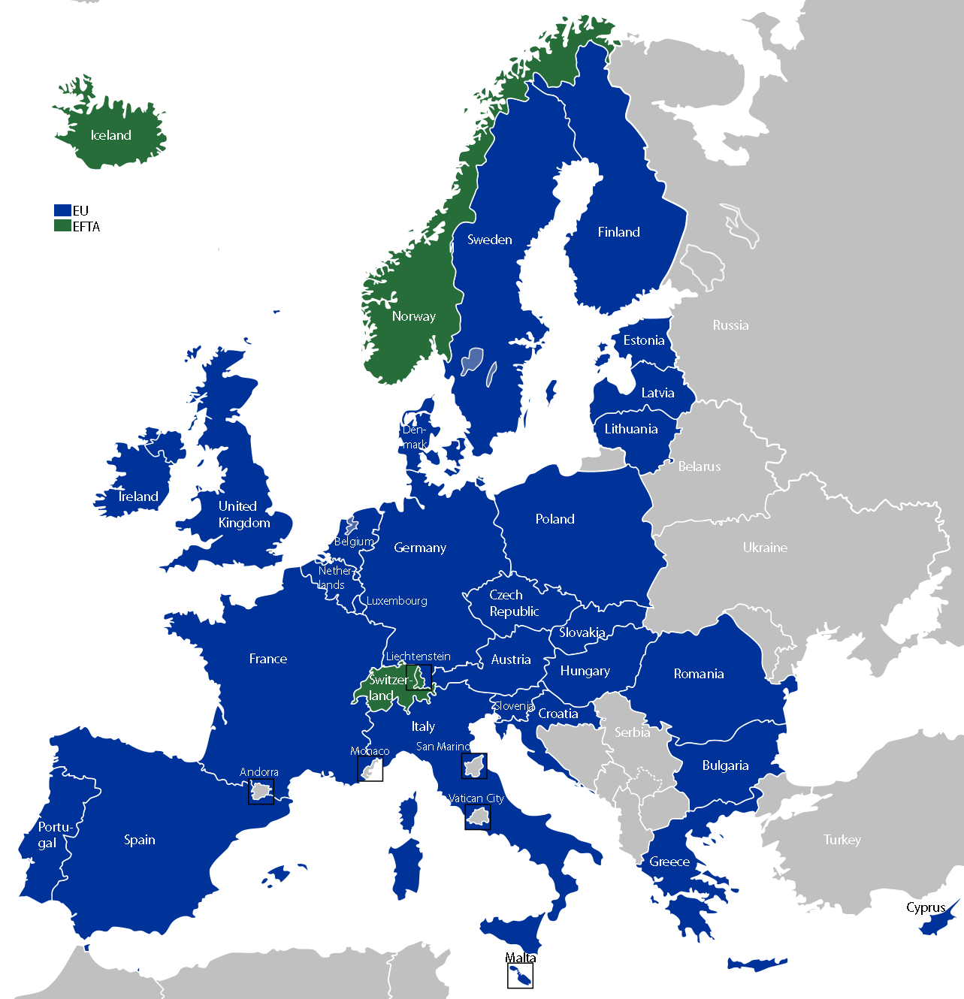

Slide 11
Where does Asia (outside the common law world) stand?
Selected legislation
Japan: New law on international jurisdiction in 2011 amending the code of civil procedure
China: Civil Procedure Act 1991
Approach
Asian legislators seem to prefer fixed rules of jurisdiction (as continental Europe), even though they have partly incorporated common law doctrines.

Slide 12
Excursus: The quest for a judgments convention
Given the different approaches to jurisdiction, why is there no Hague Judgements Convention like the Hague Service Convention?
Three attempts to reach a truly “worldwide” (or at least transatlantic) convention on jurisdiction & enforcement of foreign judgments have failed:
no compromise found, or
elaborated convention was only ratified by a handful of States
Principle opponents: EU - US
The last attempt for a broad convention was buried in 2003; instead the Hague Convention of 30 June 2005 on Choice of Court Agreements was concluded
Sign of hope: since 2011, resumed work on a “judgments project” has been undertaken in the Hague

Slide 13
How to find the relevant legal texts/rules for jurisdiction?
International Treaties (concluded between States)
International conventions contain jurisdictional rules (eg transport law conventions)
These rules take precedence over national rules if the country where the court is seated has ratified the relevant convention.
Those treaties are rare
Lex fori
Each state is free to define under which circumstances its courts shall have jurisdiction (as long as there is a genuine link between dispute and court)
Apply the rules of the lex fori (= law of the court seized), in Europe also EU law

Slide 14
Questions, discussion, quick quiz
Any questions?
What does jurisdiction mean?
Which type of jurisdiction will we discuss in class?
What is the civil law approach to jurisdiction
What is the common law approach to jurisdiction?
Where does Asia stand?

Slide 15
Thank you very much for your attention!

