Slide 1
50027 International Law
FALL 2017
Class 1
The Nature of International Law and the International System
Notes:
1

Slide 2
Class One and Two
Content:
The nature of international law as a legal system
What is international law?
Is it “real” law?
Why do nations obey international law?
A short history of international law

Slide 3
Introduction: does IL exist?
Historically IL has been derided or disregarded by famous jurists, questioning:
The existence of any set of rules Governing inter-State relations
Its entitlement to be called “law”
Its effectiveness in controlling IL actors in concrete situations
There is indeed the perception that international law is failing to promote the maintenance of an ordered community (weak protected from the arbitrary action by the strong)

Slide 4
IL is not perfect, as domestic legal systems
Several successes and failures
Kuwait/Iraq and reaction of the international community, UN failures in Bosnia, Somalia, Sudan
Guantanamo and human rights, Pol Pot, Rwanda
East Timor independence, the International Criminal Court
East Asian Sea- China vs. Philippines, Vietnam, etc.
Domestic legal systems
Law not enforced, crimes not detected and punished…
Comparing domestic and international law is wrong
Different systems (individuals vs States, existence of a superior entity vs horizontal relations among actors)

Slide 5
What is IL?
International law = rules governing international relations, facilitating the functioning of the international community
Rules regulating the relations between actors: States and other subjects (e.g. international organizations, minorities etc.)
Very wide scope!
IL also regulates the conducts of States in their relations to individuals (of other States or its own nationals)
IL is NOT the only facilitator or controller of State conduct (diplomacy, politics, foreign relations strategies)

Slide 6
IL as a System of Law
Members of the international community recognise that there exists a body of rules binding upon them as law
States believe that IL exists
IL is practiced on a daily basis (e.g., at the diplomatic level)
States never claim that they are above the law or that IL does not bind them
Majority of rules are observed (the apparent ineffectiveness stems from the fact that law-breaking receive more attention than compliance)
Unsofisticated approach to adjudication and enforcement – affecting its strength

Slide 7
Enforcement
Common concern: IL is not enforceable/not enforced
General view: «Hallmark of a system of law is that its rules are capable of being enforced»
Is enforcement relevant to determine whether a set of norm is a legal system?
Domestic law: the validity of «law» may depend on the way it is created (method regarded as authoritative by the legal subjects to whom it is addressed)
Enforcement can be the reason why individuals obey the law, but it is not the reason why it is «law»
Therefore, in IL the fact that rules come into being in an «authoritative» manner should be enough to ensure that IL «exists»

Slide 8
Enforcement of IL
1. The UN Security Council
UN Charter: «enforcement action against a State when it poses a threat to the peace, or has committed an act of aggression or breach of the peace»
Use of force, economic sanctions or other measures
However, the main function of UN SC is to preserve the peace rather than enforce the law (even if this might coincide, e.g. Iraq/Kuwait case) – e.g. in an armed conflict the first action of the SC is to order the «ceasefire»

Slide 9
Enforcement of IL (2)
Loss of rights and privileges
E.g. Violation of terms of a commercial treaty might result in a complete suspension
Penalties impose by the international community as a whole
E.g. Suspension of diplomatic relations, expulsions of diplomats, suspension of a State from an international organization, etc.

Slide 10
Enforcement of IL (3)
Judicial enforcement by the ICJ (main judicial organ of the UN)
States may not accept its jurisdiction
Enforcement of awards: limited (even if SC might be involved)
Ad hoc Courts
International Criminal Court
National Court of States (individual vs State or individual vs individual)
Other Courts created by treaties (e.g. Trade)

Slide 11
Effectiveness
Why international law does work:
Common good
Social consequences («psychological Rubicon»)
Practictioners of International Law
Flexibility
Political Costs
Sanctions

Slide 12
The weaknesses of International Law
It depends on the political will of sovereign States
Lack of Institutions
(especially a central organization responsible for law-creation)
Lack of certainty (vs flexibility)
Vital interests
Vital rules

Slide 13
International law at present
Int’l law is, in great part, the legal system regulating global economy
IMF and WTO
Maritime demarcation
Other fields regulated by modern int’l law:
Law of treaties
Law of State responsibility
Dispute settlement
Criminal law?

Slide 14
Evolution of international law
Global economic relations demand a global legal framework
But globalization is more than economic: it’s cultural and social
Globalization is a challenge for int’l law: it requires the exercise of authority on the global level
New actors (individuals, NGOs, etc.), new problems (taxation, immigration, etc.)

Slide 15
History / 1
“Modern” int’l law begins in the 17th century
But it existed before
1648: Peace of Westphalia (State system definitively came to existence)
End of medieval powers of the Pope and the Empire in Europe
Creation of Sovereign States
States replaced other entities (city-States, feudal entities and leagues of trading posts), which lacked the capacity to ensure commitments and control a territory

Slide 16
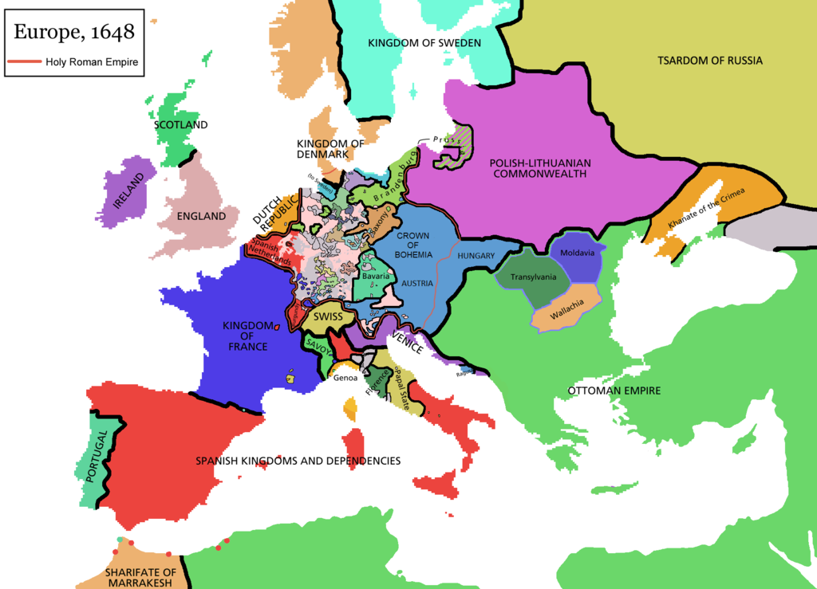

Slide 17
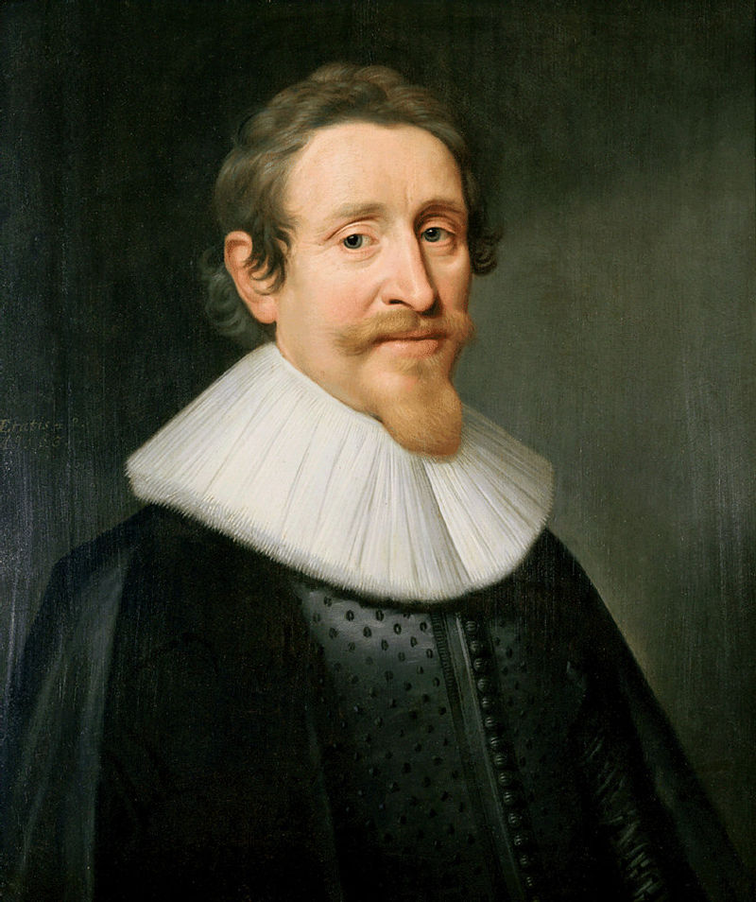
Hugo Grotius
Dutch (1583 -1645)
University of Leiden at 11!
First book at 16!

Slide 18
History / 2
1625: Grotius: On the Law of War and Peace
One society of states, governed not by force or warfare but by actual laws and mutual agreement to enforce those laws
A theory of free trade among peoples
Freedom for the high seas
It was the first to present a synthetic, comprehensive vision of international law
Why did he develop the theory of free trade?
Other scholars (Vitoria, De Vattel) developed the idea of an international legal order

Slide 19
History / 3
Opposition between Christian and non-Christian States
Theorization of the European superiority
Capitulation system (XVII-XVIII centuries)
any treaty whereby one state permitted another to exercise extraterritorial jurisdiction over its own nationals within the former state’s boundaries. (sovereignty over persons)
Privileges to Europeans in Non-European countries
Right to practice public worship of Christian faith
Freedom of trade and commerce
Reprisal against Europeans prohibited
Special jurisdiction

Slide 20
Imperialism and Colonialism
Imperial powers (Spain, Portugal, Holland and Great Britain)
Expansions on the seas
Grotius’ theory that the seas are not terra nullius, but terra communis (= common property, not susceptible to occupation and sovereignty) – (Dutch interests)
GB claimed exclusive sovereignty around British islands (maritime zones)
Much of the world became the playground of European powers…and the non European world?
Slavery
Abolished starting from the seventeenth century, gradually arriving to prohibition
Key role played by int’l law

Slide 21
Summary: The Int’l Legal System / 1
Crucial element: absence of a single overarching authority (superiores non recognoscens)
There is no police force in int’l law
Responsibility (and enforcement) centered on the same subjects which violated the rules
A law that works without sovereign authority
A law based on morality only? How can it work without a sovereign authority?
It actually works quite well and is respected most times (…)

Slide 22
The Int’l Legal System / 2
Important roles played by:
Routine and habit (established practice)
Lawyers (especially in the Ministries)
Reciprocity (with some limitations!)
Legitimacy (as exercise of “compliance pull”)
Social sanctions are in play
States have to interact each other
A regime sanctioning violations exists
Sanctions | Retorsions | Countermeasures | Self-Defense and collective security actions

